Slide 1
Photomicrographs of Plant foods
Corn
Permission to reproduce original photomicrographs used to make this collection may be obtained from
Dr. David O. Norris at
david.norris@colorado.edu

Slide 2
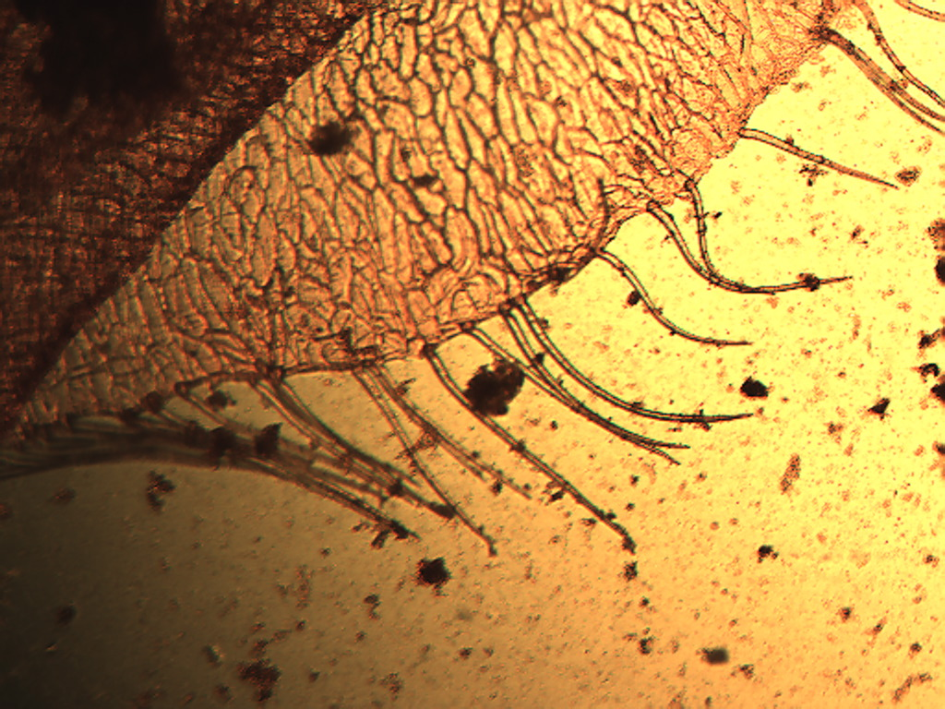
Notes:
135. Zea mays L. Corn. Testa (seed coat) epidermis with trichomes (arrows), safranin stain, 4X. These can be readily separated from the epidermal cells.

Slide 3
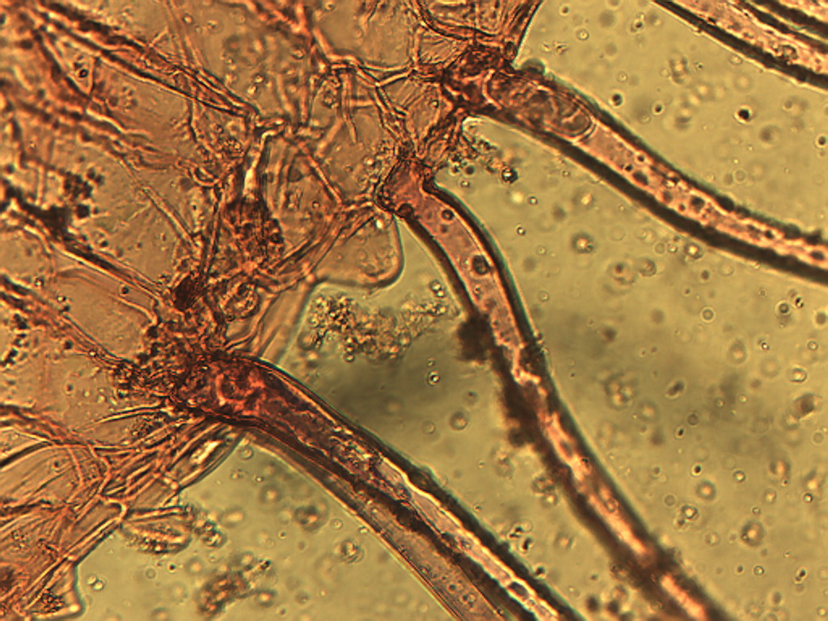
Notes:
136. Corn. Showing attachment of trichomes to seed coat epidermis, safranin stain, 25X.

Slide 4
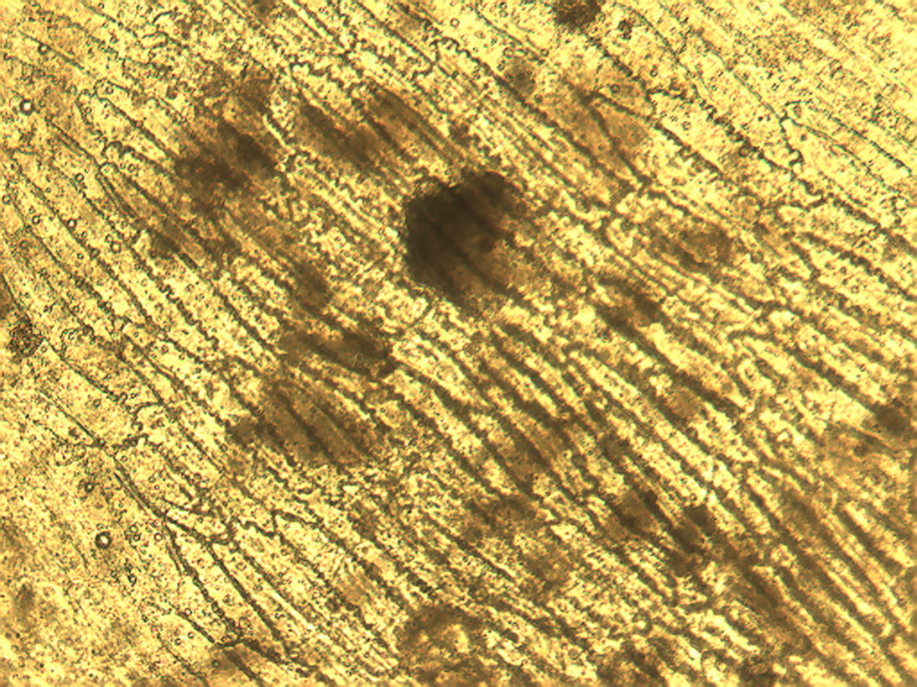
Notes:
137. Corn. Testa (seed coat) epidermal cells, 10X. Note how cells are connected to each other.

Slide 5
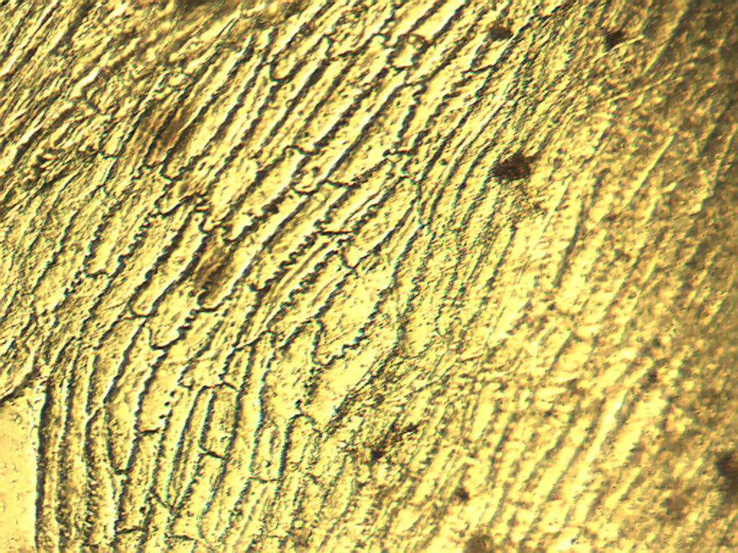
Notes:
138. Corn. Testa (seed coat) epidermal cells showing negative response to staining for starch, 10X.

Slide 6
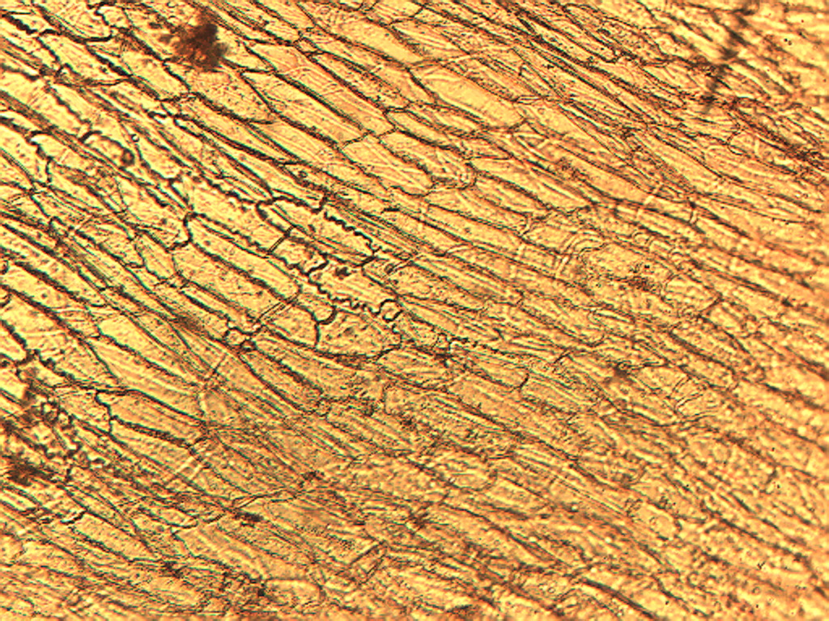
Notes:
139. Corn. Testa (seed coat) epidermis stained with safranin, 10X.

Slide 7
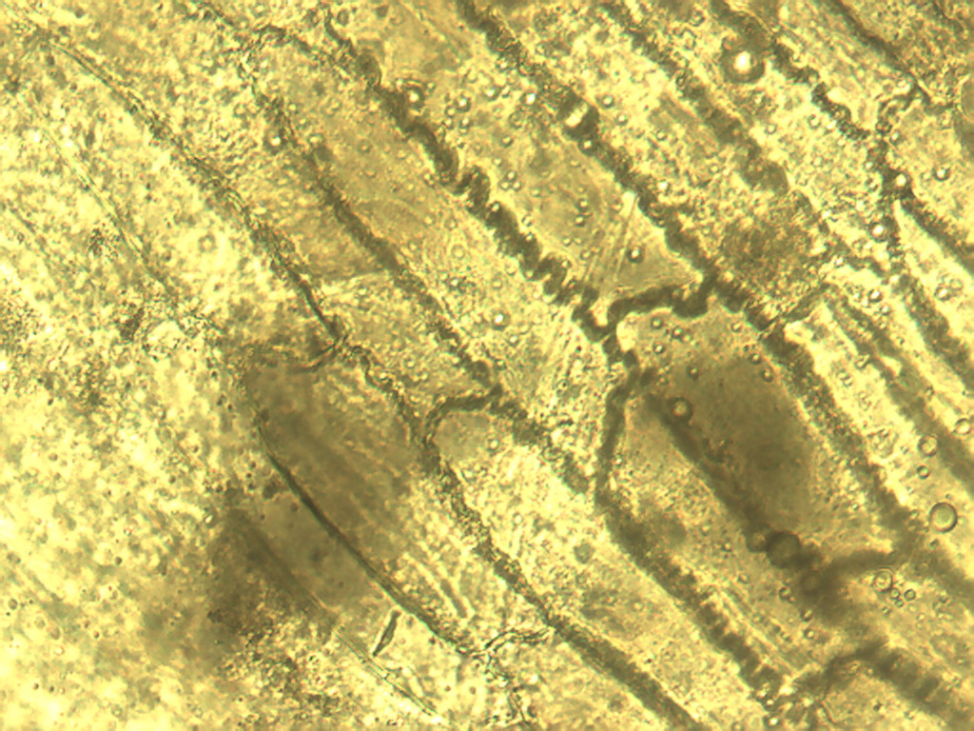
Notes:
140. Corn. Seed coat (testa) epidermal cells emphasizing interdigitation of cell walls (arrows), 25X.

Slide 8
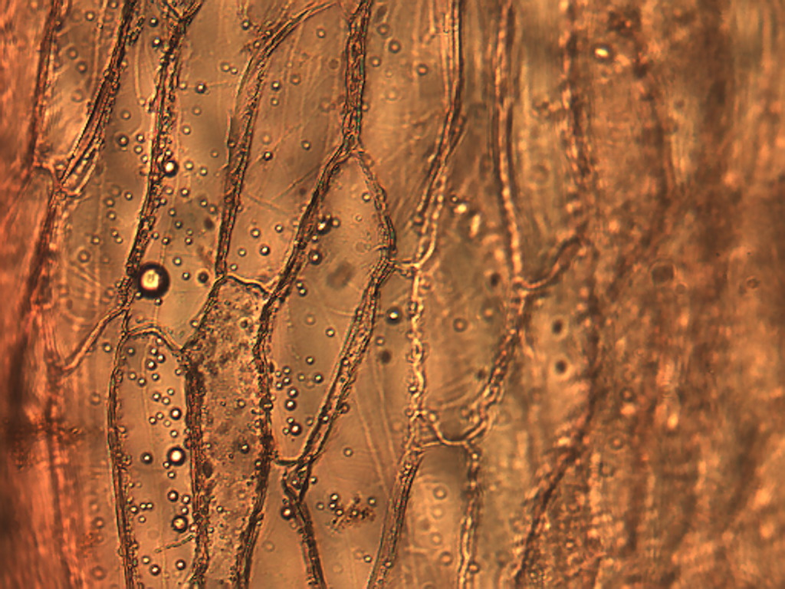
Notes:
141. Corn. Seed coat (testa) epidermal cells stained with safranin, 25X.

Slide 9
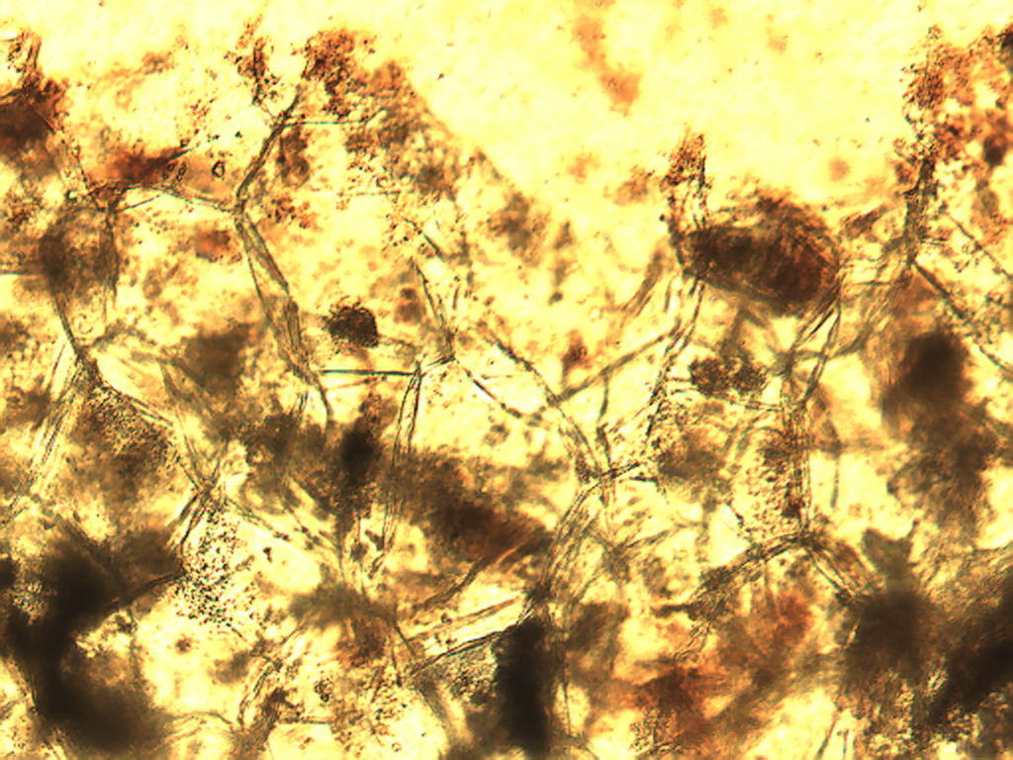
Notes:
142. Corn. Large pulp parenchymal cells stained with safranin, 10X.

Slide 10
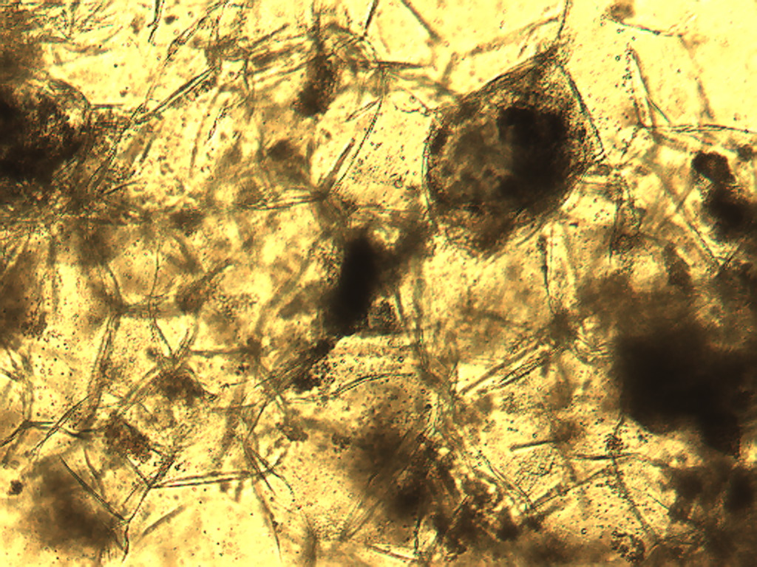
Notes:
143. Corn; large pulp parenchymal cells stained for starch (black), 10X

Slide 11
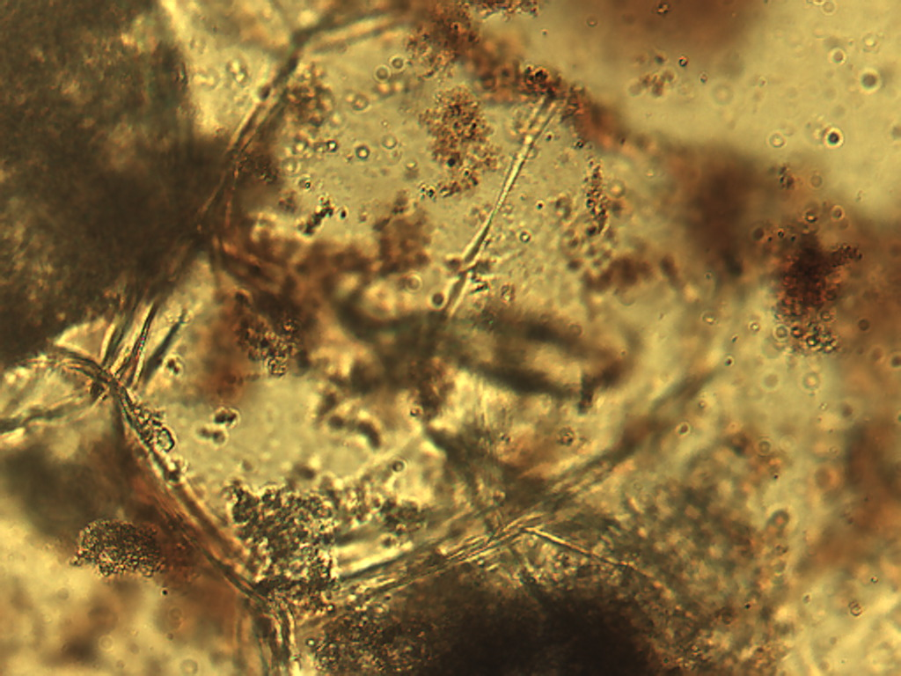
Notes:
144. Corn. Large pulp parenchymal cell stained with safranin, 25X.

Slide 12
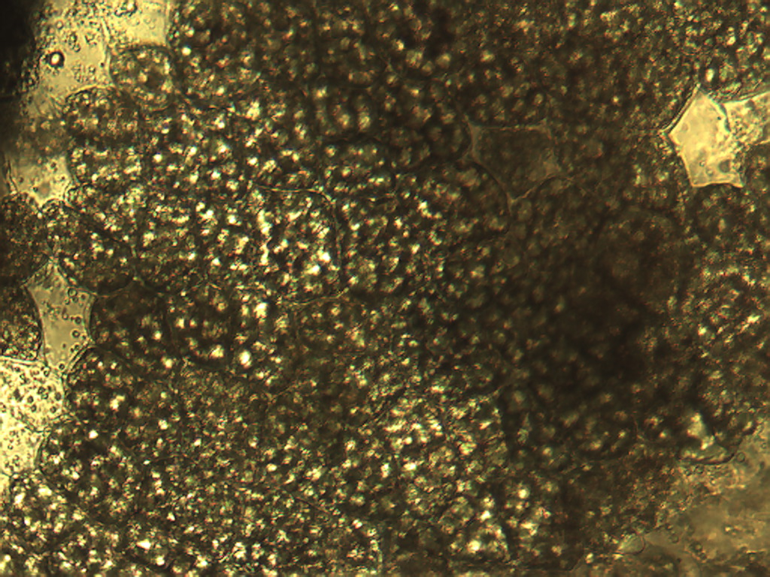
Notes:
145. Corn. Small pulp parenchymal cells stained for starch, 25X.

Slide 13
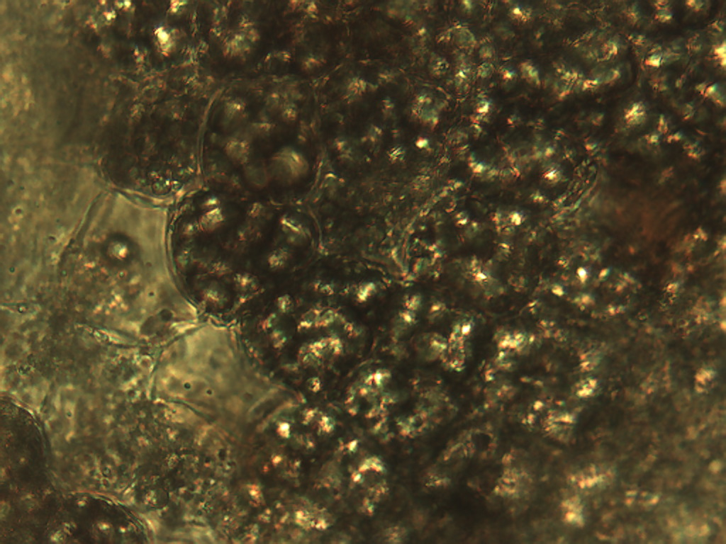
Notes:
146. Corn. Small pulp parenchymal cells stained for starch, 40X.

